Slide 1

ORGANIZATION NAME : GOVERNMENT OF MAHARASHTRA
THEME NAME : SMART EDUCATION
PROBLEM CODE : OS871
PROBLEM STATEMENT : ATTENDANCE SYSTEMS FOR STUDENTS
OF GOVERNMENT AIDED SCHOOLS
COLLEGE CODE : C-16590
TEAM NAME : LOYALTY LEAGUE
MENTOR NAME : DR. G. NALINIPRIYA
TEAM LEADER NAME : V. SIVA VADIVU RAGAVI

Slide 2
IDEA:
Developed Smart Attendance system for Government Aided School.
Student database is created
Attendance will get updated in excel sheets.
Present and Absentees list is recorded in separate excel sheet.
For Absentees, mail will be sent to their care takers.
At any point of time student recent location is tracked.
The software has been developed for the desktop Application and mobile application(future development).
Student attendance data analysis are generated for further improvement of the student.

Slide 3
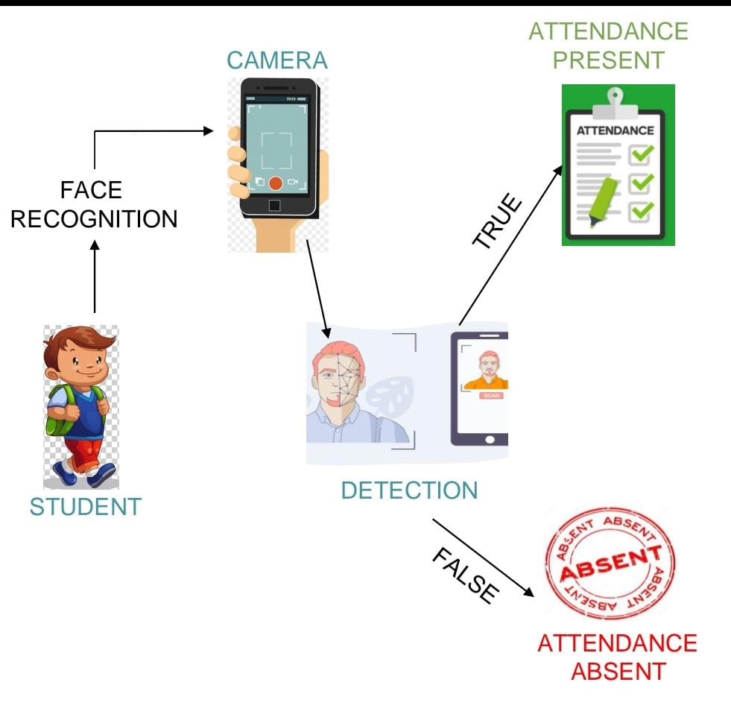
WORKFLOW:
Image will be captured and stored in Database
Detection of multiple faces through nodal Points.
Image Detection will be done by Histogram
Oriented Gradient Algorithm.
Images are captured using camera.
Datasets are feed to Machine Learning algorithms .
After Image contouring and finally Image is detected.
Attendance Marking process will be Recorded in Excel
Sheet.
Data Analysis of student Attendance is generated.

Slide 4
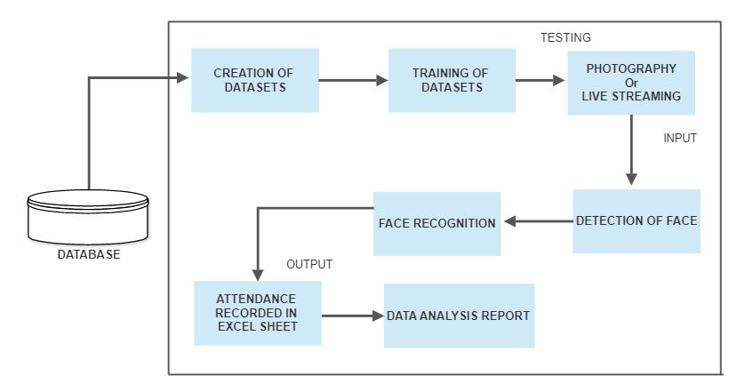
System Architecture

Slide 5
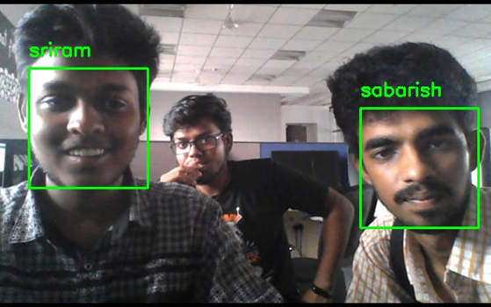

Key features:
No separate software is needed-SaaS(Cloud Computing)
Minimum time is spent for taking attendance
Proxy of attendance will be avoided.
Students will be Monitored regularly.
Digital Technology is implemented at Affordable Cost.
To avoid impersonate in National level or state level exams like NEET , UPSC .
Data Analysis can be done so that the Teacher work can be minimized.
Tools and Technologies:
PyCharm
Visual Studio
Google AppScript

Slide 6
Conclusion:
In our Smart Attendance Management system, the camera will capture the image and the faces are detected using machine learning algorithm and then they compare with the faces in the database .
This system support multi-user attendance and face detection at the same time.
The accuracy of attendance recognition is tested in different scenario and the experimental result shows that the system achieves a good performance in real time government school scenario.
In future, the system can be extended by using Advanced Cloud Computing , Deep Learning and IoT Technologies for practising and implementing “Digital India” successfully in government schools.

Slide 7
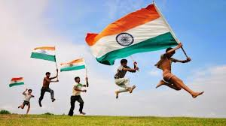
PRESENTED BY LOYALTY LEAGUE (TEAM NAME)
GUIDED BY
DR G NALINIPRIYA
TEAM LEADER
SIVA VADIVU RAGAVI V
TEAM MEMBERS
ANANDASAYANAM K
HARIRAM B
KAVYA V G
SARAN E
AKILA VENKATA SESHA SAI

